Slide 1
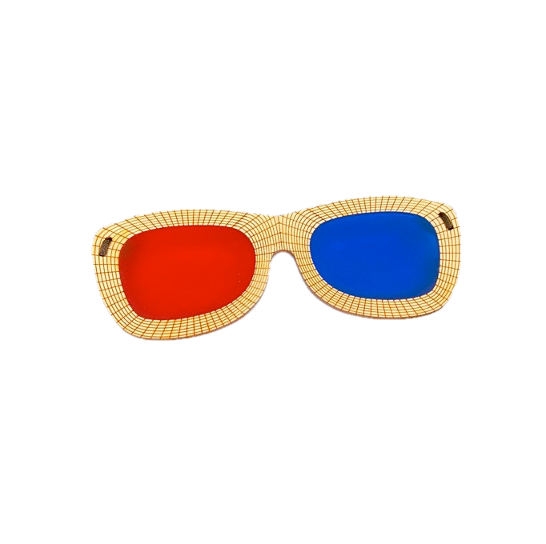

Do My Eyes Work Together?
Most people whose eyes don’t work together don’t have stereopsis or 3D vision, and they don’t even know that it’s missing.
The brain is so amazing at adapting! When a person doesn’t develop normal 2-eyed vision (binocular vision), the brain tries to make up the difference by using cues like shadows, size and movement to determine depth so we aren’t running into walls or chairs.
While these adaptations are amazing, 3D vision is a whole different story. The extent of your 3D vision can only be determined with the tools found in an eye doctor’s office, but there are plenty of tests that can give you an idea of how well your eyes are working.
Try these next few tests and see if your brain is using one eye or both eyes!
If you need help, click here to sign up for a free consultation with me and I will guide you through the process.
Disclaimer: This is not a substitute for being diagnosed by a licensed professional. It is simply a fun look at how your eyes are coordinating together. If any of the tests are difficult or you are unable to complete them. I recommend finding a developmental optometrist who can help you train your brain to use both eyes together!

Slide 2
Test #1
Your eyes probably aren’t working well together if…
Hold up a pencil between you and the big blue circle.
Look at the circle. Notice how many pencils you see.
Look at the pencil. Notice how many circles you see.
This can be difficult, even for people with “normal” vision so just relax your eyes and be patient.
When looking at the the circle or pencil you only see one of each.
Your eyes are probably coordinating well if…
When looking at the the circle or pencil you see two of each.
When looking at the pencil you see one pencil and two circles, one on either side of the pencil.
When looking at the circle you see one circle and two pencils, one on either side of the circle.
For normal binocular vision, the object the eyes are focused on should be single while objects behind or in front should be double.

Slide 3
Test #2
Hold a pencil in front of the blue circle.
Close the left eye, does the pencil shift?
Close the right eye, does the pencil shift?
Your eyes probably aren’t working well together if…
When you cover one eye, the pencil stays in the same spot, and when you cover the other eye it jumps far to one side.
Your eyes are probably coordinating well if…
When you close your left eye, the pencil moves slightly to the left. When you close your right eye, it moves slightly to the right, both sides centered.

Slide 4
Test’s #3-6 require anaglyph red/green or red/blue glasses
The red should go over the right eye and the green/blue over the left eye. Use the two circles on the right to test whether your glasses are canceling properly.
If you don’t have those glasses, there are a few options.
Buy some from my website
Buy some from Amazon
Use red/blue overlay and make your own, even just holding the overlay over each eye could work for a quick test.
Don’t worry about the last few slides.
Put on your red/blue glasses and then look at these two circles to make sure you have red on the right and blue on the left.
Cover your left Eye and you should only see this circle
Cover your right eye and you should only see this circle

Slide 5
Test #3
Good News:
Put on red/blue glasses
Look at each image and notice what you see:
Both lines meet in the middle and are lined up vertically and horizontally
Bad News:
The lines do no meet
in the middle
You only see one line
The lines are off horizontally
This test tells whether you are using and coordinating both eyes together and doesn’t give any definitive answers on whether you have 3D vision or not. If the eyes aren’t both working together, you probably aren’t seeing in 3D or you may have limited 3D vision.

Slide 6
Test #4
Put on red/blue glasses
Look at each image and notice what you see:
Bad News:
Good News:
You only see one line:
Both lines meet in the middle and are lined up vertically and horizontally
The lines are off vertically
The lines do no meet in the middle
This test tells whether you are using and coordinating both eyes together and doesn’t give any definitive answers on whether you have 3D vision or not. If the eyes aren’t both working together, you probably aren’t seeing in 3D or you may have limited 3D vision.

Slide 7


Test #5
Put on red/green/blue glasses.
Look at the lightbulb
Try looking up close and then slowly back up.
If you aren’t sure, try covering and uncovering one eye to see if there is a difference when using both eyes.
Your 3D Vision is Probably Stellar if:
The lightbulb instantly appears to be floating about halfway between you and the screen at all distances.
You Probably Lack or have Limited 3D vision if:
-The lightbulb appears to be on the screen of the computer.
-You see two lightbulbs with glasses on.
-The lightbulb switches between floating and being level with the screen.
-You can see the depth at some distances, but not others.

Slide 8


Test #6
Put on red/green/blue glasses.
Look at the lightbulb
Try looking up close and then slowly back up.
If you aren’t sure, try covering and uncovering one eye to see if there is a difference when using both eyes.
Your 3D Vision is Probably Stellar if:
The lightbulb instantly appears to be floating behind or inside the screen at all distances.
You Probably Lack or have Limited 3D vision if:
-The lightbulb appears to be on the screen of the computer, not floating.
-You see two lightbulbs with glasses on.
-The lightbulb switches between floating behind and being level with the screen.
-You can see the depth at some distances, but not others.

Slide 9
Now What?
If these tests were a struggle, impossible, or gave you a headache, there is a good chance that you may have issues with your binocular vision (two eyed vision).
Some people are totally fine living without 3D vision and aren’t worried about it because it isn’t affecting their daily life.
Others struggle with reading, driving, sports or other activities and want to improve their vision.
If you want to discus your individual case with me, I’m happy to consult and you can sign up for a zoom session by clicking the link below. I love helping people find their perfect solution to their vision problems!
I have learned so much about strabismus and its treatment options in the last three years and would love to point you in the right direction.
I do not diagnose or treat vision problems.
Click here to sign up for a Zoom Session

